Slide 1
Create a recipe from scratch
Step by step

Slide 2
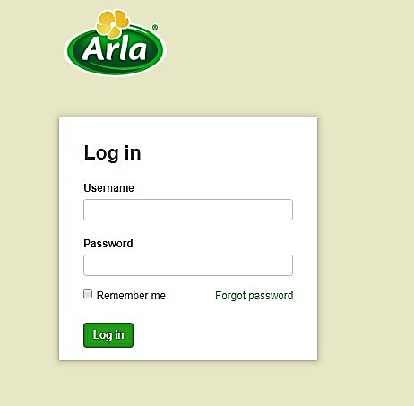
Step 1. Login to RDB
Open https://rdb.arla.com
Enter your login name and password, press Log in button

Slide 3
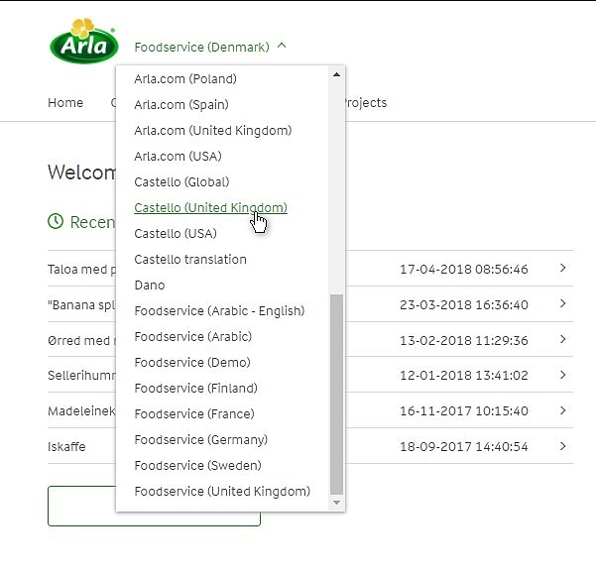
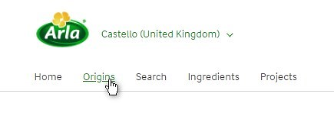
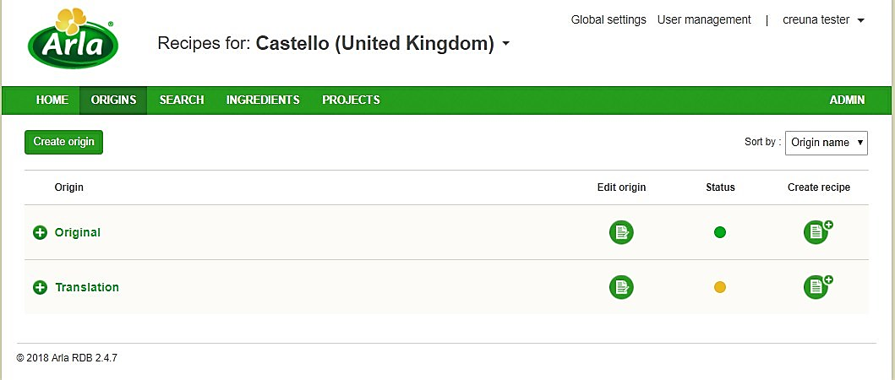
Step 2. Choose the Market, open Origins
Choose the market, where the new recipe will be created
Open the list of available origins, where the recipes are locating, by click on Origins link
Each origin could be treated as usual folder that contain recipes:
The Original origin contains recipes, that are created from scratch;
The Translation origin contains recipes, that were translated from another markets.

Slide 4

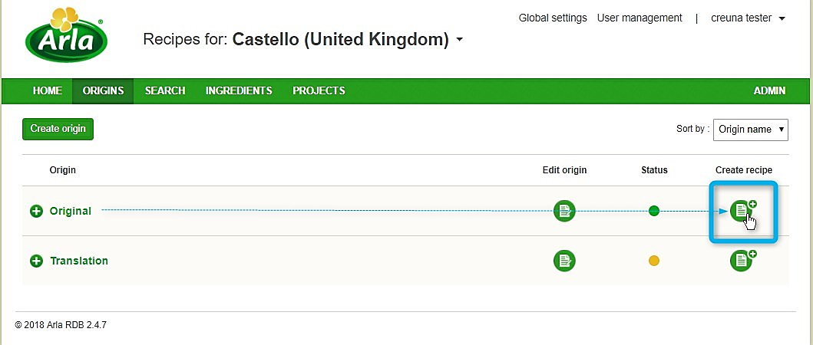
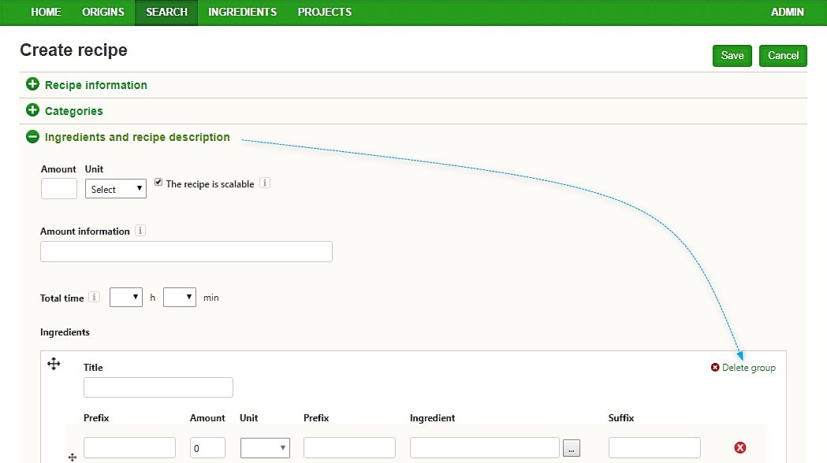
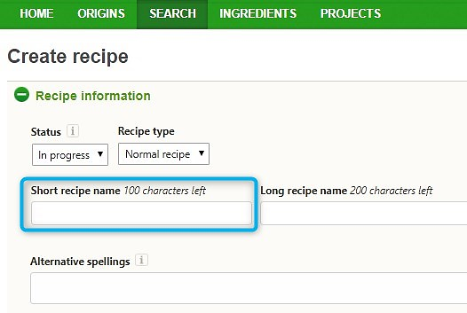
Step 3. Create recipe basis entering minimum required data
To start creating a new recipe click on Create recipe icon in front of name ‘Original’.
Expand Recipe information section and set Short recipe name
Expand Ingredients and recipe description section and delete the empty ingredients group.
Press Save button.

Slide 5
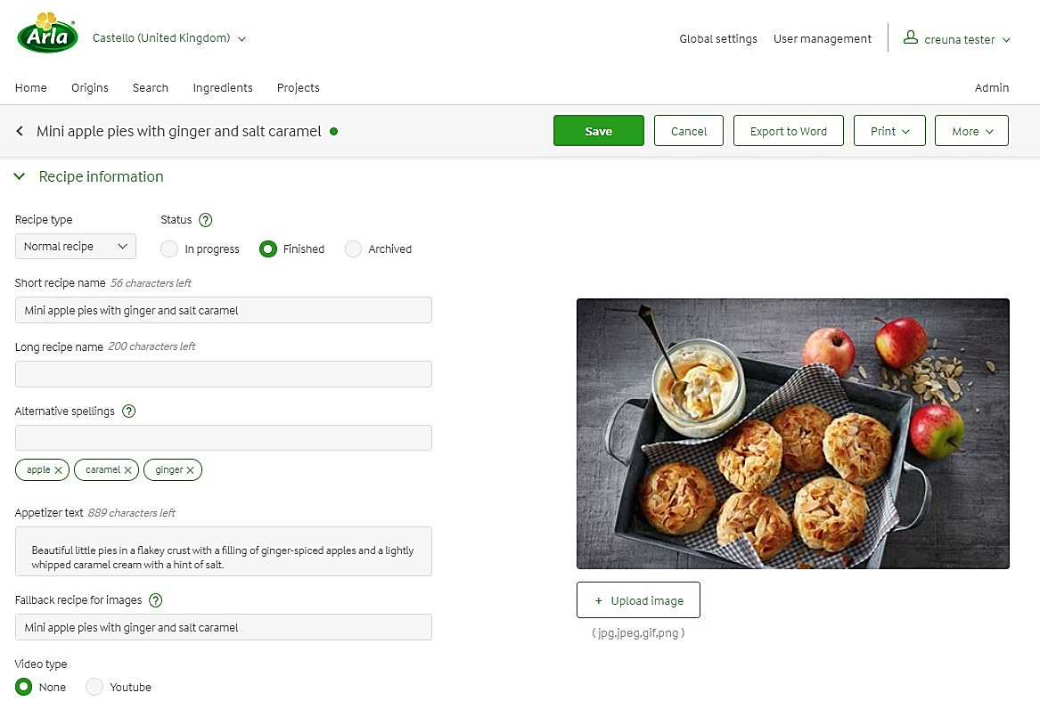
Step 4. Recipe information section
Some fields could be skipped as they are not in use on Castello website. So, fill in the following fields (they are also not mandatory, and could be left empty) :
Recipe type – Normal or Easy depending on total time preparation, but could be left Normal by default.
Status – In progress by default and it should stay In progress until the recipe is ready to be shown on the website. When everything is done, the status should be changed to Finished.
Short recipe name – is already filled out (in previous step).
Alternative spellings – put the keywords by which the user could find the recipe using search on the website. Type the keyword and press ENTER, do so word by word.
Appetizer text – shown on the recipe page as an intro to the recipe.
Upload image – the image is represented on the recipe page and it can be specific for different markets.
Fallback recipe for images – if the image is not uploaded, then editor can specify the recipe from where the image could be shown. By click in the field choose the fallback recipe.
Video type – None by default. If the video should be added please click Youtube and put the video ID to the appropriate field (f.e. if the full link is https://www.youtube.com/watch?v=Z1ssscoMRi4 , then the video ID is Z1ssscoMRi4)
Don’t forget to Save your changes.

Slide 6
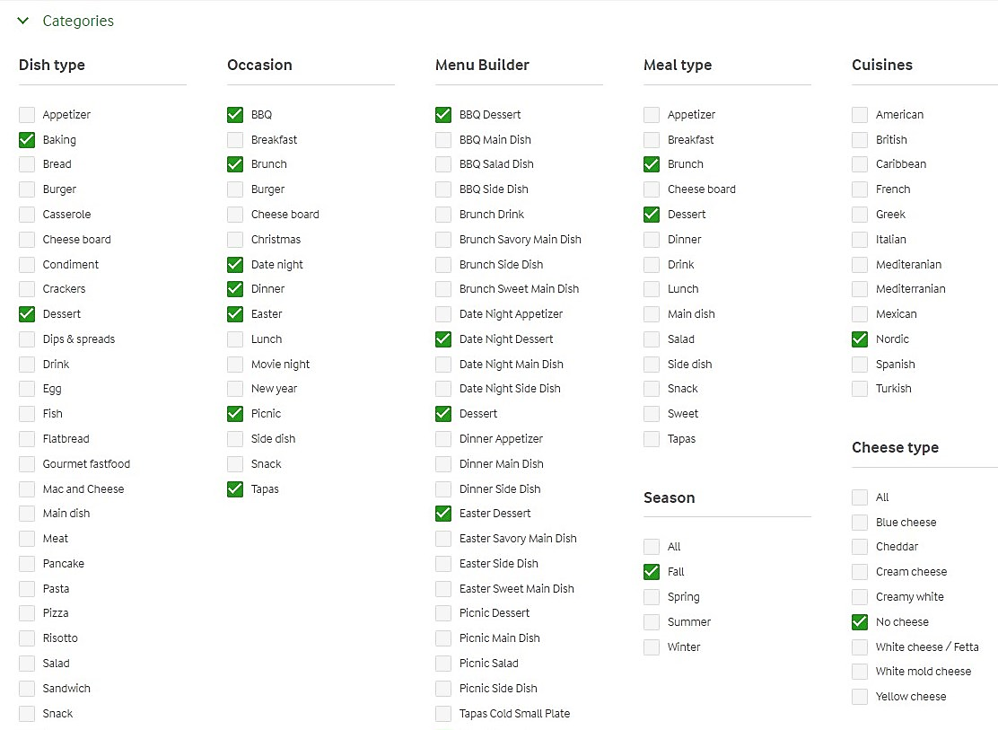
Step 5. Categories section (Tagging)

